Slide 1









Sentiment ANALYSIS
SAI SRUTHI
RAGHUNANDAN
CHEKITHA

Slide 2


PROBLEM STATEMENT
To build and identify a suitable classification model for the sentiment analysis of customer reviews using multi-layer perceptrons (opinion mining)

Slide 3


ABSTRACT
Eases the task of manually reviewing the customer sentiments.
Builds a suitable MLP model for sentimental analysis of customer reviews.

Slide 4
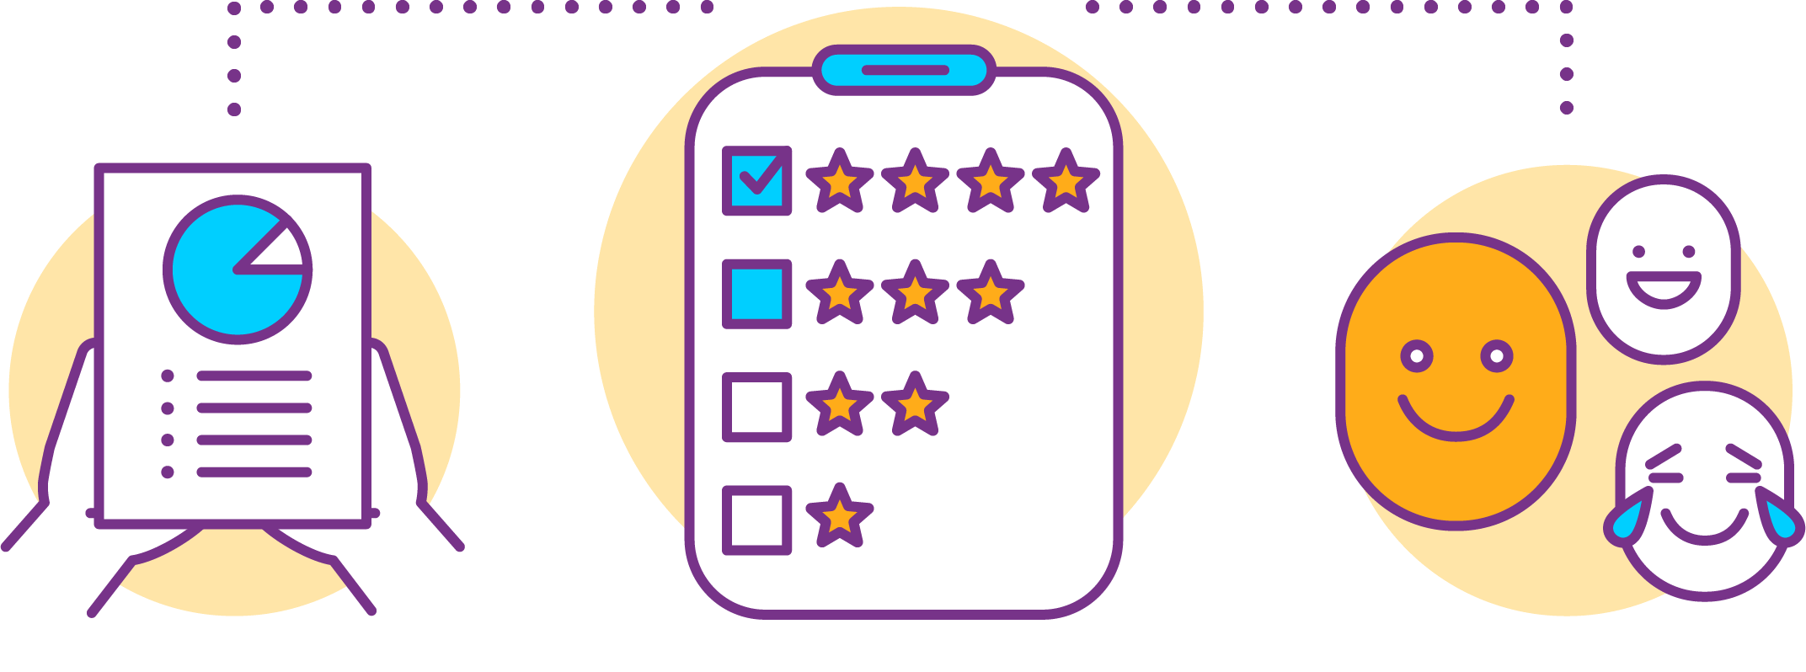
Introduction
Sentiment analysis process by which information is extracted from a writing that has different polarities
Multi-class
1. Positive
2. Negative
3. Neutral

Slide 5
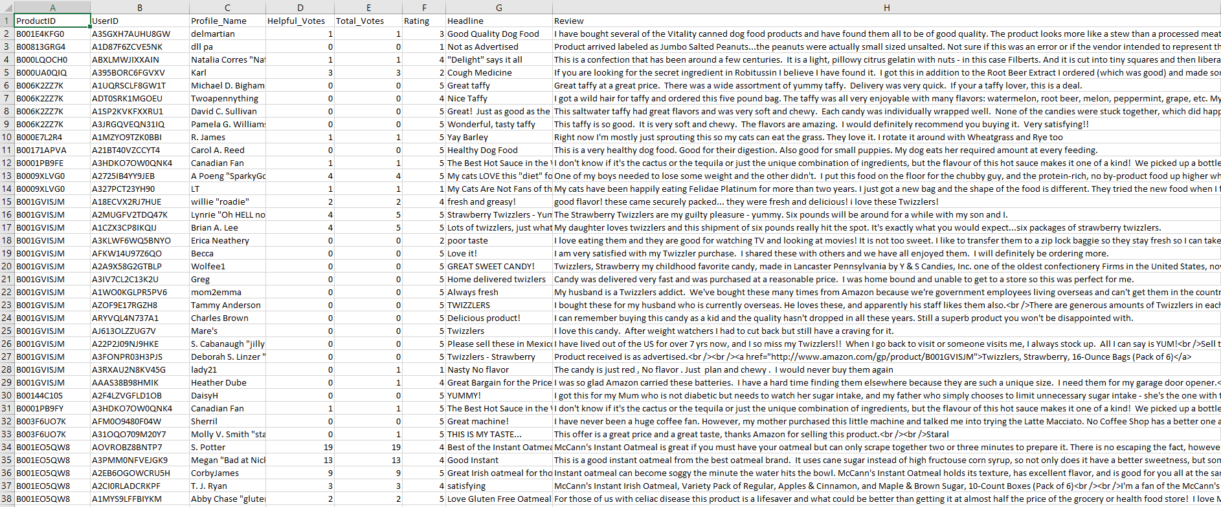
DATASET

Slide 6
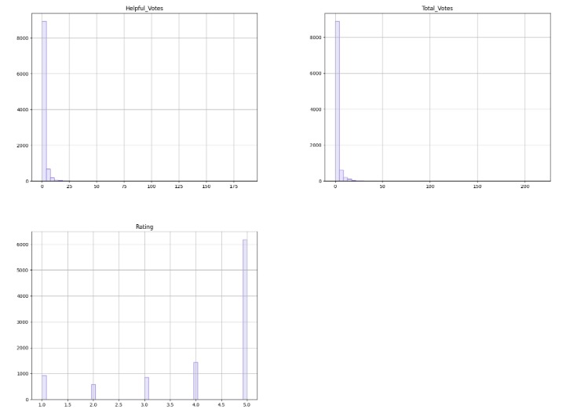
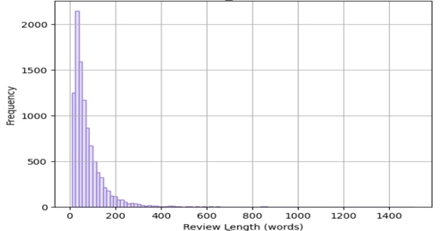
PRE-PROCESSING

Slide 7
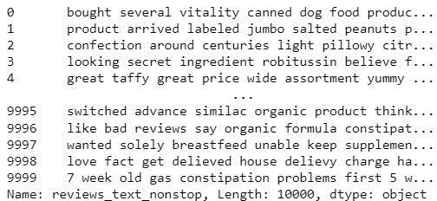
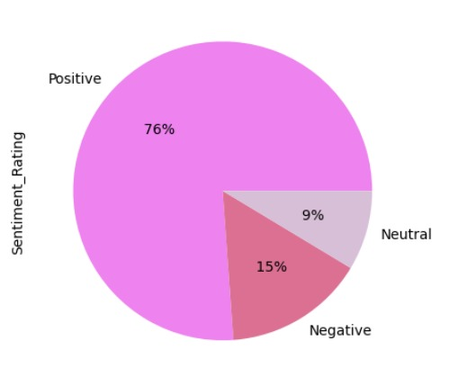
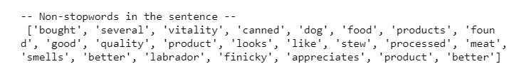

Slide 8

FEATURE EXTRACTION
As computers can’t work on strings, the review text is converted into a numerical representation of vector form and this is referred to as featurization. There are various featurization techniques available such as
Bag-of-words
TFIDF vectorizer
Word2vec

Slide 9
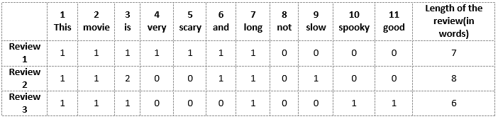
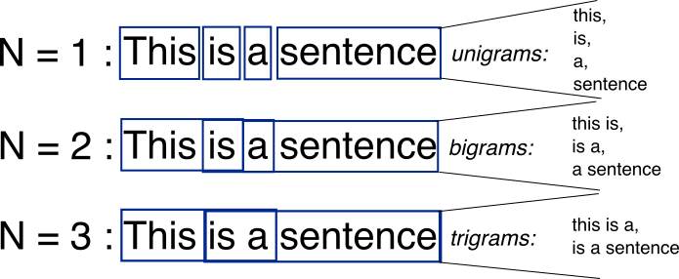

Slide 10

APPLICATION DOMAINS
Social media monitoring
Customer support management
Analyzing customer feedback
Product analysis
Market research

Slide 11
MLP (Multi-Layer Perceptron)
Layers – Input layer, hidden layer, output layer
Activation function - Tanh
Backpropagation algorithm
Cost function – MSE

Slide 12




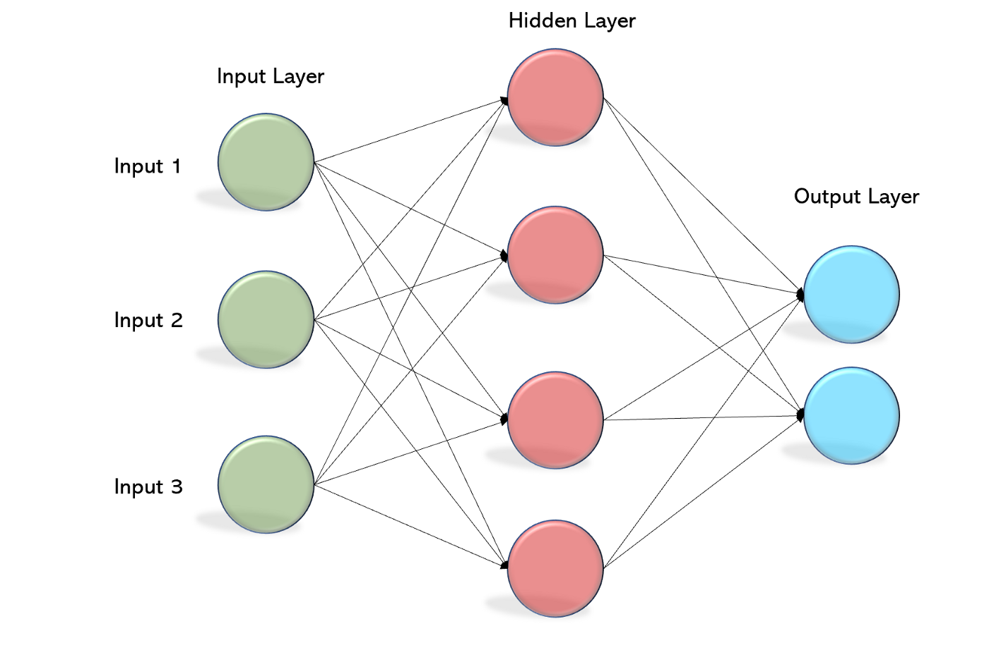



Slide 13

POTENTIAL CHALLENGES
Multilingual reviews
Other languages written in English
Grammatical errors
Using modern abbreviations

Slide 14

Libraries and Software
NLTK
Sklearn
Matplotlib
Numpy
Pandas
Python
Jupyter Notebook

Slide 15

BASELINE METHODS and HYPERPARAMETRS
SVM
Logistic Regression
KNN
Epochs : 100
Learning Rate : 0.1

Slide 16
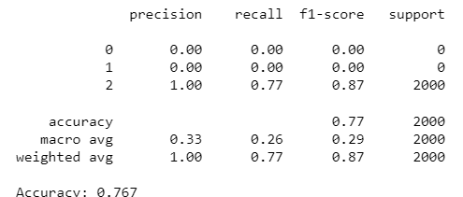
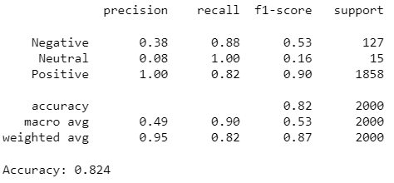
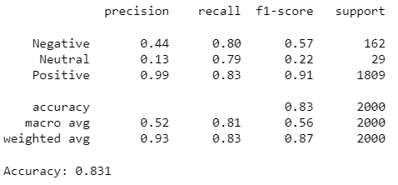
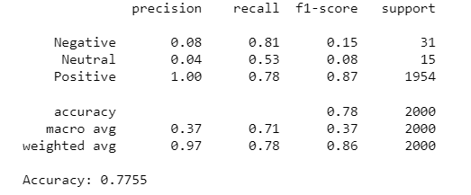

RESULTS and Evaluation Metrics
MLP model
SVM Model
Logistic REGRESSION
KNN

Slide 17
Further Improvements
Testing the method on a wider range of tasks.
Investigating the linguistic phenomena that may or may not be captured
Optimizing the layers

Slide 18



Thank you!

